Slide 1

OOP with Python
Making virtual objects in the computer and a game!

Slide 2
What's covered?
What is OOP?
Classes, Attributes & Objects
Encapsulation
Protection Levels
Hands-on Activities (guided!)
Secret Project ☺

Slide 3
What is OOP?
1

Slide 4

What is OOP?
A paradigm that bases programming in modular concepts (objects, classes, subclasses, etc.)
Primarily has four principles:
Encapsulation (we’ll be briefly covering this!)
Abstraction/Generalisation
Polymorphism
Inheritance

Slide 5

OOP Examples
Take for example a Person class:
Each person has certain attributes:
Name
Age
Identification Number
Each person also has certain behaviours (methods):
walk()
talk()
work()
study() ☹
Notes:
OOP in short summary is made up of classes and objects.

Slide 6

OOP Examples
Take for example a Car class:
Each car has certain attributes:
Brand
Model
Colour
Price
Each car also has certain behaviours (methods):
start_engine()
accelerate()
stop()
Notes:
OOP in short summary is made up of classes and objects.

Slide 7
Classes, Attributes & Objects
2

Slide 8
What are Classes, Attributes & Objects?

Slide 9
Classes
Classes are blueprints for creating objects
E.g., Person is a blueprint that can represent John
Classes create a structure for attributes and define methods for objects
Attributes: characteristics that an object holds; variables to store data within an object
E.g., Person(Name, Age, ID)

Slide 10

Attributes
Characteristics that an object holds; variables to store data within an object
E.g., Person(Name, Age, ID)
Name
Age
ID

Slide 11

Objects
Instances of classes: think of them as things created from a blueprint (classes)
Have their own defined values for the attributes
Can use the methods that are defined in the class
Example (with a person class)
John is a person with the attributes → name, age and ID
Miss Jamie is also a person with the attributes → name, age and ID
John
15 y/o
s1234
Notes:
Briefly talk about values of attributes for the object

Slide 12
How do we code it out?

Slide 13
Classes
`main.py`
class Person:
def __init__(self, name, age):
self.name = name
self.age = age
def printInfo(self):
print("{}, {} y/o".format(self.name,self.age))

Slide 14
What is a Constructor?
A special function or method to initialize a class
Declares and assigns the initial values for attributes
Usually applicable to other programming languages too!
Attributes
def __init__(self, name, age):
self.name = name
self.age = age
Notes:
Can briefly talk about self as well when initiating the class, and the attributes that are passed in and how they are initialised in the following codes.

Slide 15
Creating an object
Create an object by calling the constructor of the class
Follow the format you specified in your constructor for the order of attributes to declare!
def __init__(self, name, age):
first
second
johnObj = Person("John", 19)

Slide 16
What is a Method?
Methods: functions that objects can perform
Usually used to perform operations on attributes
Returns a modified value or Prints a value
Some examples include:
Printing name of a person object
Calculating age of a person object
def printInfo(self):
print("{}, {} y/o".format(self.name,self.age))

Slide 17
Methods (How do you call them?)
Methods are inside objects
Use the object to call the method!
objectName.methodInObject(args)
Object name
Method name
Parentheses
johnObj.printInfo()
def printInfo(self):
print("{}, {} y/o".format(self.name,self.age))
Notes:
Good to briefly touch that it is possible to pass in arguments in the parentheses for whatever uses

Slide 18
Accessing Object Attributes
Use the object to access public attributes
objectName.attributeName
print(johnObj.name)
Output:
John

Slide 19
Modifying Object Attributes
Use the object to access the attribute
Modify the attribute accordingly
p1.name = "Tom"
print("This person's name is " + p1.name)
Output: This person’s name is Tom

Slide 20
Encapsulation
3

Slide 21
Encapsulation
Involves bundling data and methods together in a single unit
Implemented through classes where data members and methods are grouped
Promotes modularity in code

Slide 22
Protection Levels
4

Slide 23
Protection Levels
Public | Private
Attributes or methods → can be accessed outside of the class | Attributes or methods → can only be accessed within the class
Can be called via objects of the class | Cannot be called via objects of the class
Denoted by default, without 2 underscores | Denoted with 2 underscores

Slide 24
Activities!
5

Slide 25
Exercise 1 💪
Create a class to represent a car. The class should have attributes for the car’s brand, speed, model, year, and colour. The class should also have methods to start the car, stop the car, and honk the horn.
Feel free to write any code for now inside the methods: we want to see if you got things right with making a class!
Extra: label the attributes, methods, and constructor

Slide 26
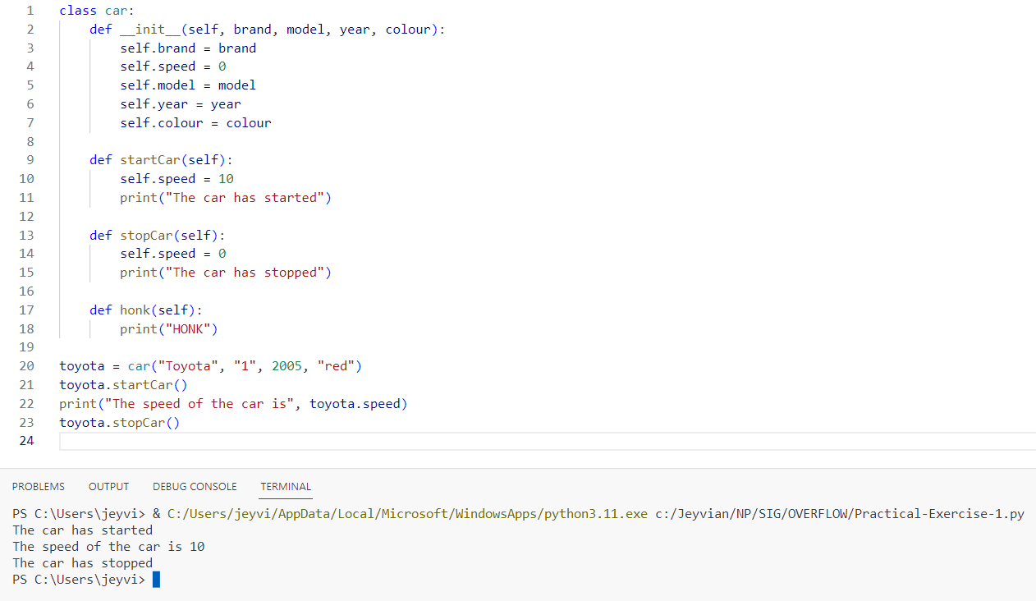
Exercise 1 💪

Slide 27
Exercise 2 💪💪
Add on to the previous exercise. The car class should have an additional attribute for the car's top speed. The class should also have a method to set the top speed.

Slide 28
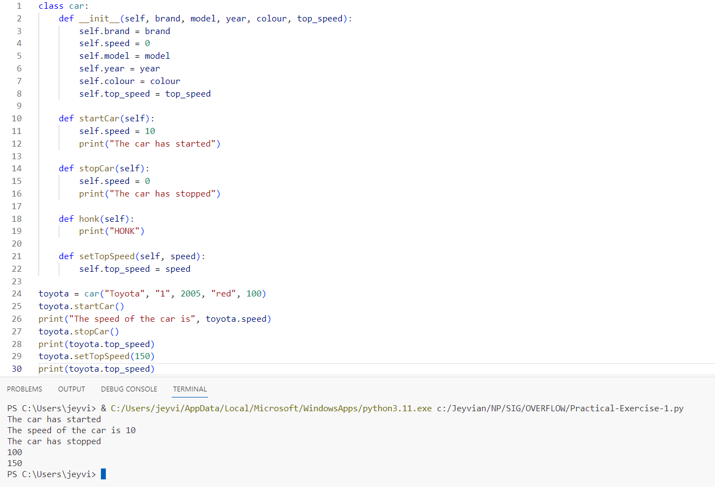
Exercise 2 💪💪

Slide 29
Exercise 3 💪💪💪
Create a class to represent a bank account. The class should have attributes for the account holder's name, the account number, and the account balance. The class should also have methods to deposit money into the account, withdraw money from the account, and check the account balance.

Slide 30
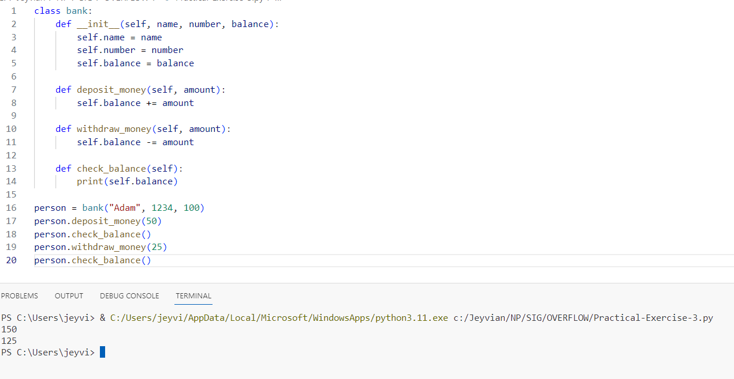
Exercise 3 💪💪💪

Slide 31

BREAK TIME!
6

Slide 32
Surprise Project ☺
7

Slide 33

But before that…

Slide 34
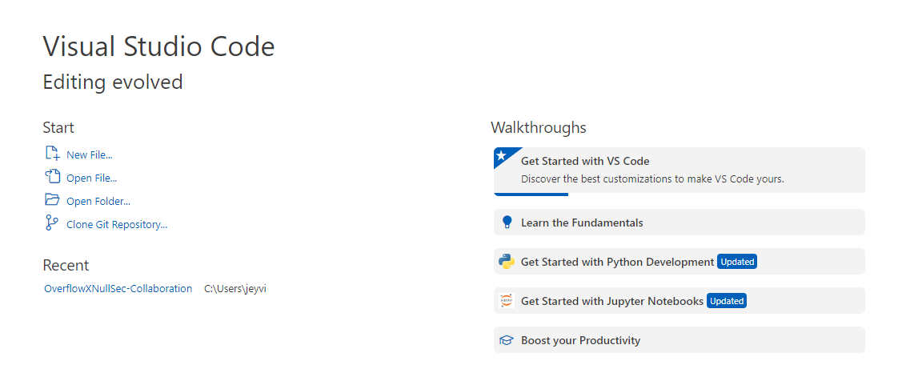
Creating New Python File
Create a new Python file

Slide 35
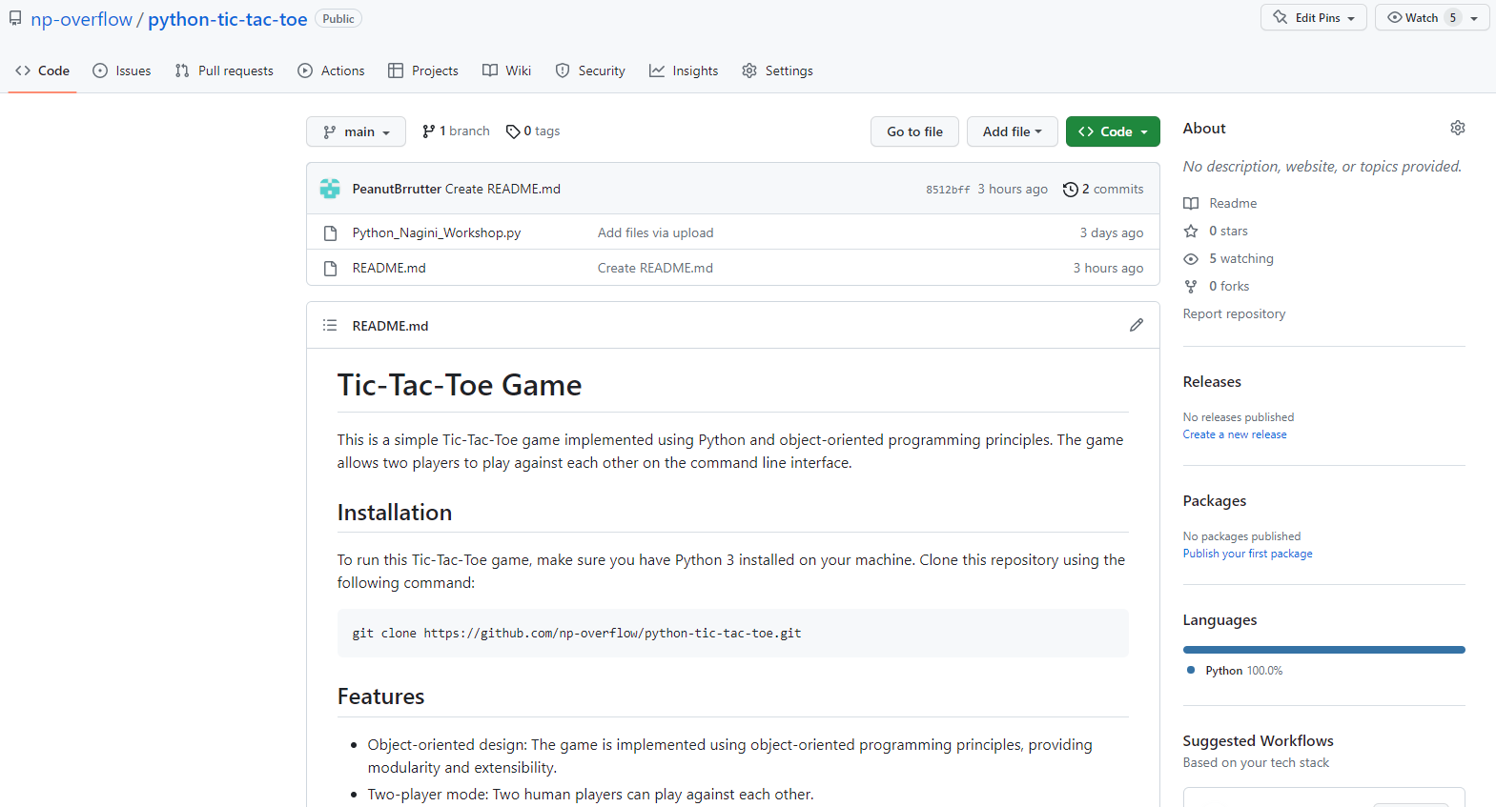
Go to the Repository
Go to https://tinyurl.com/OverflowPythonWorkshop

Slide 36
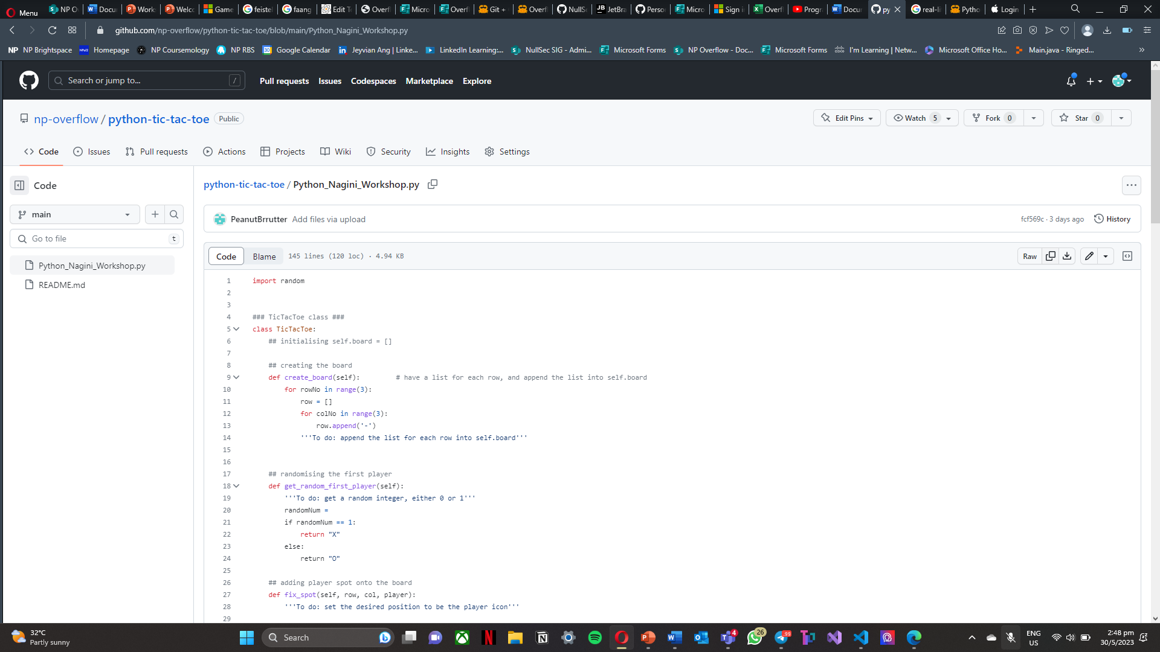
Copy & Paste the Code
Copy the code in the Python_Nagini_Workshop.py file on GitHub
Paste it in your own python file

Slide 37
Let’s get CODING
8

Slide 38
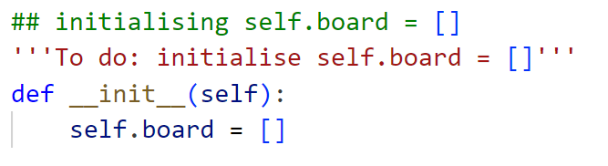
Initializing self.board
Set self.board to be an empty list
Make sure your init method is surrounded with 2 underscores on both sides

Slide 39
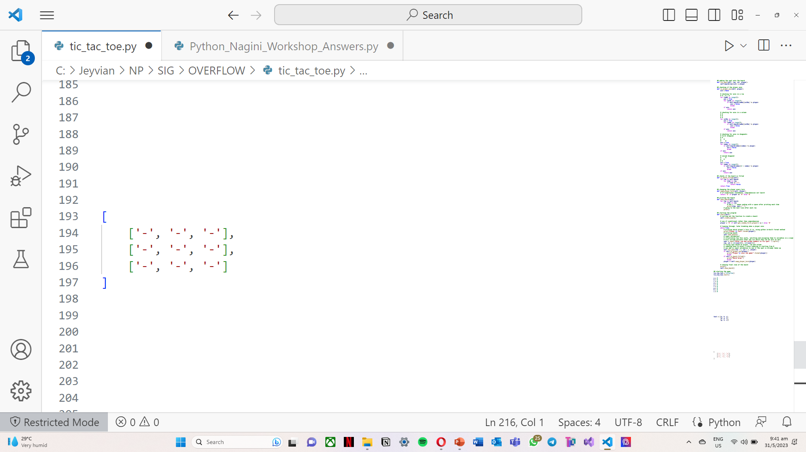
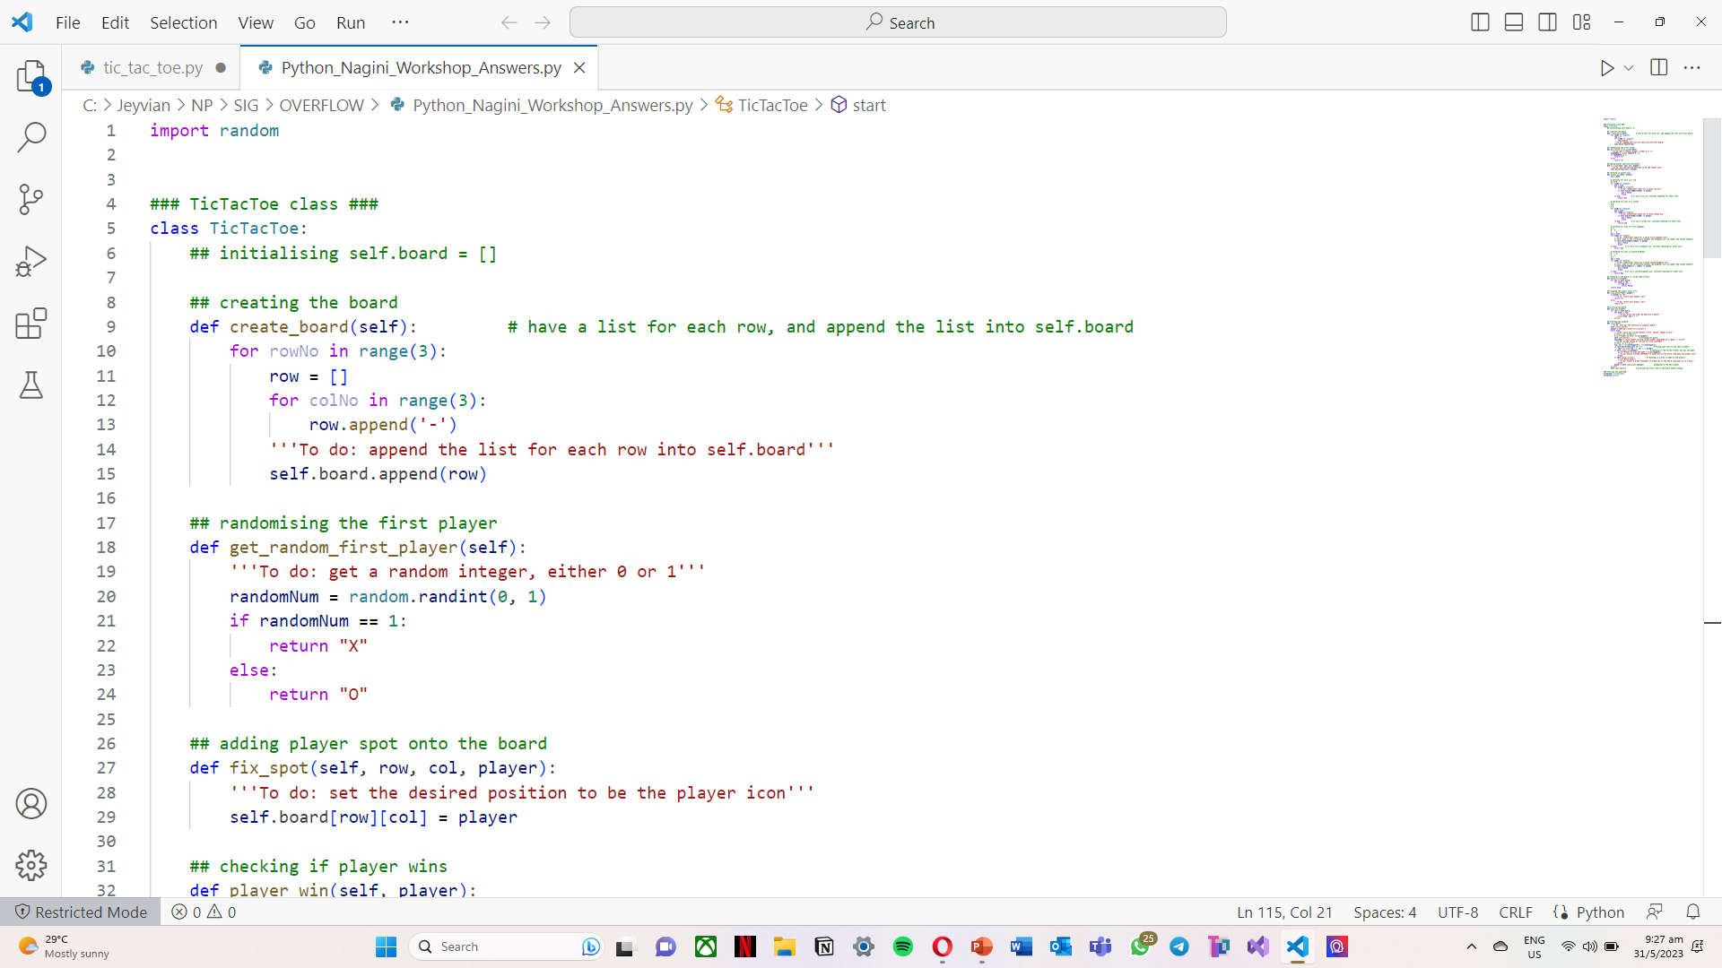
Creating the Board
Creating a new list for each row
In the list, append how many columns there are to the row list
Append the row list to the board list
Repeats for the number of rows

Slide 40
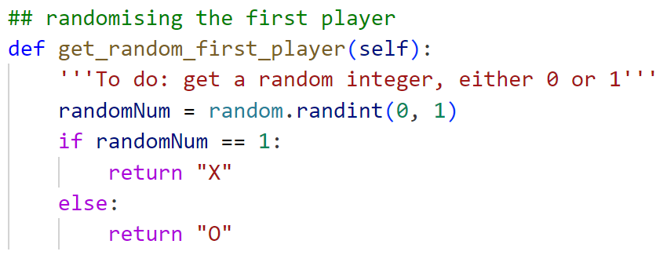
Randomizing the First Player
Getting either 0 or 1 randomly, returning first player according to random number

Slide 41
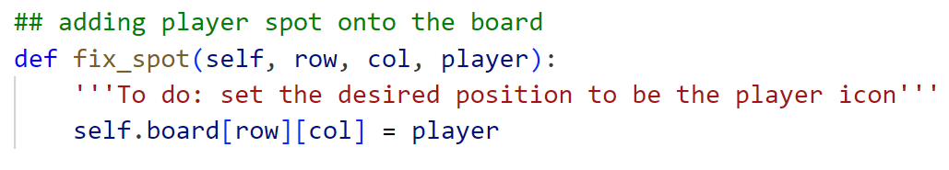
Adding Player Spot onto the Board
To access a particular spot in a nested list, the indexing is
nested_list[rowNumber][columnNumber]

Slide 42
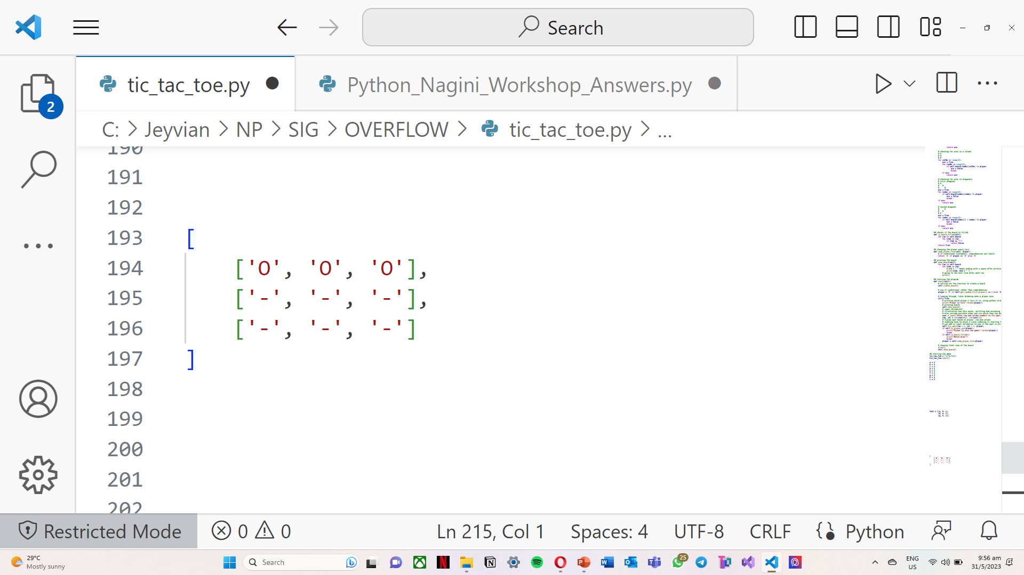
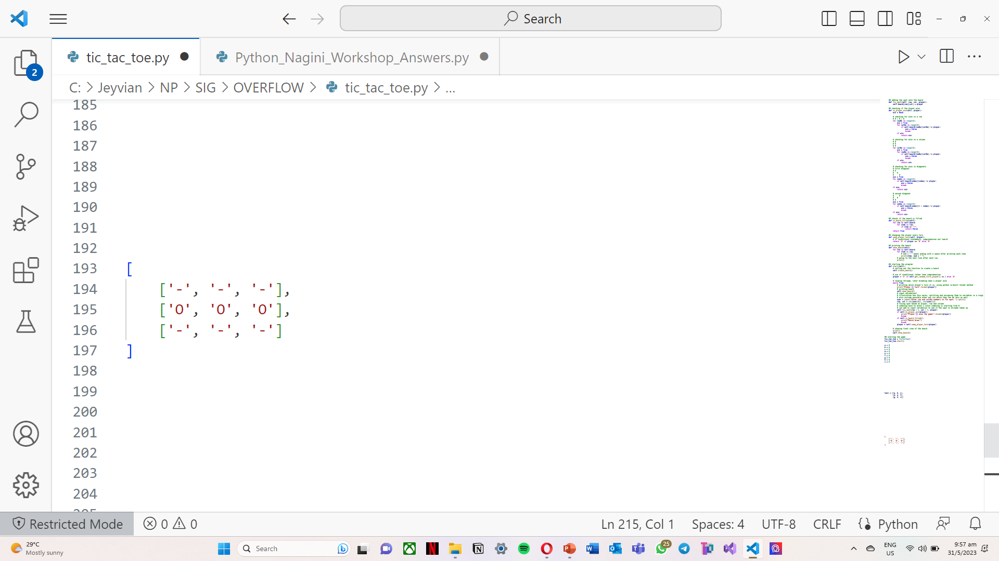
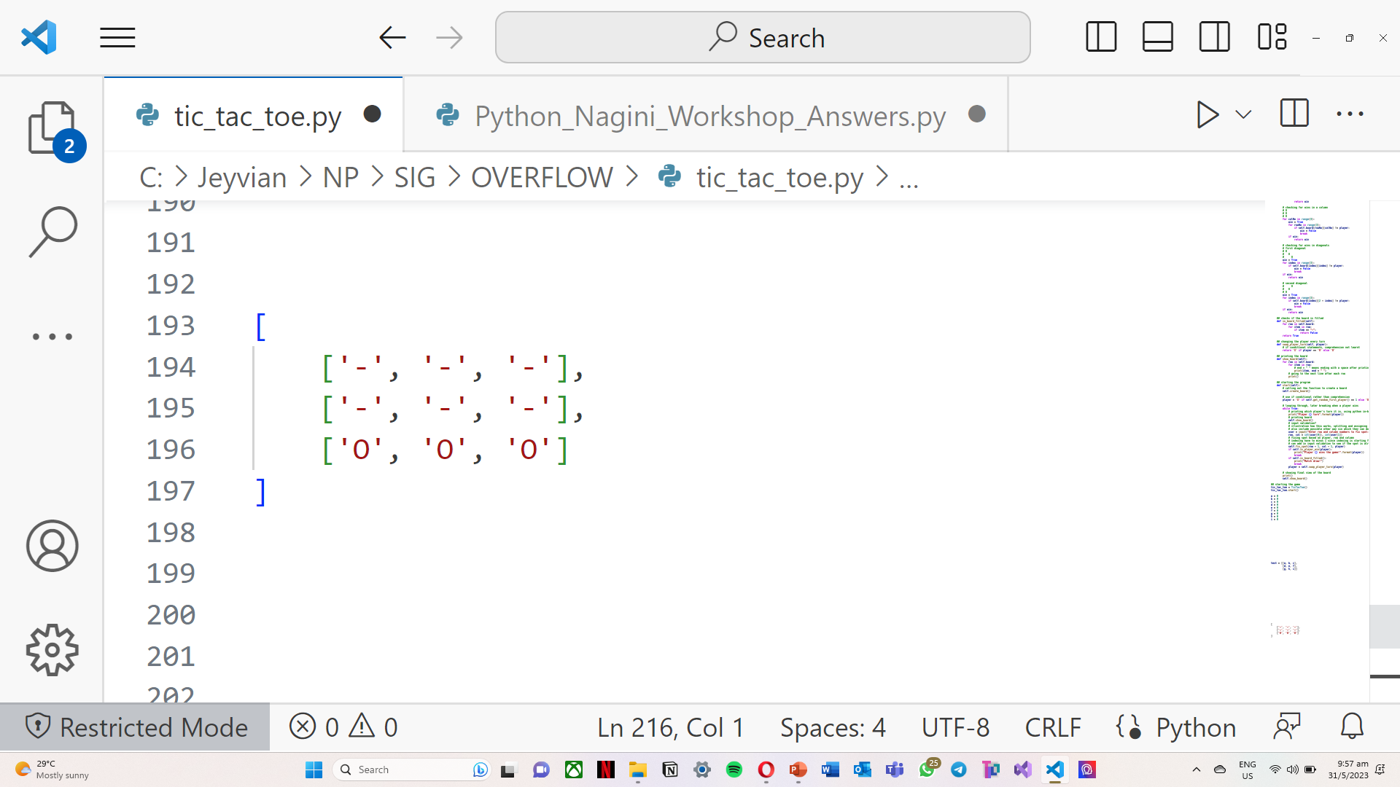
Win – Row
First Row:
nested_list[0][0]
nested_list[0][1]
nested_list[0][2]
Second Row:
nested_list[1][0]
nested_list[1][1]
nested_list[1][2]
Third Row:
nested_list[2][0]
nested_list[2][1]
nested_list[2][2]

Slide 43
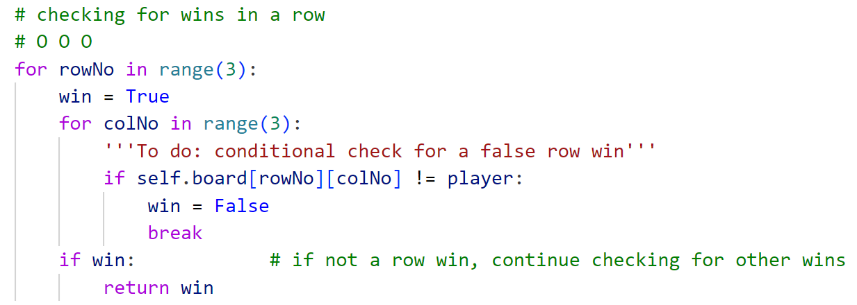
Win – Row
Notice that each row win have the same row number (first index)
Hence loop through each row first then the column to check for a row win

Slide 44
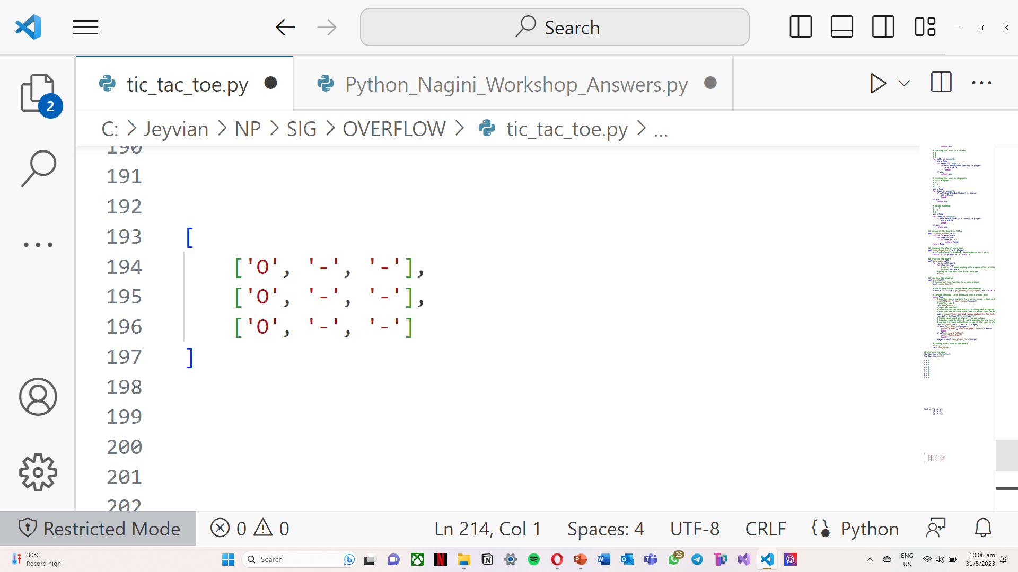
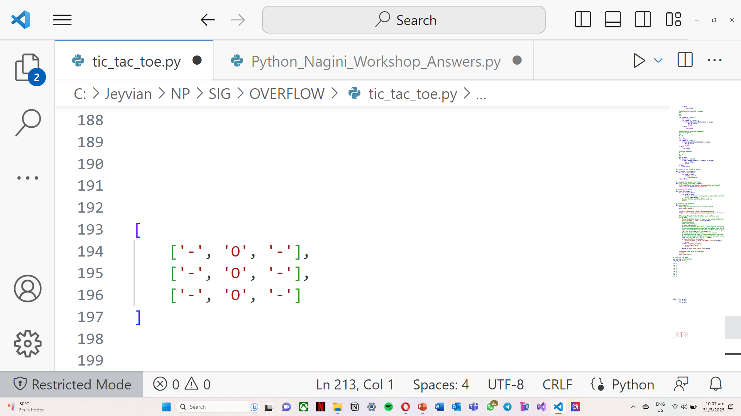
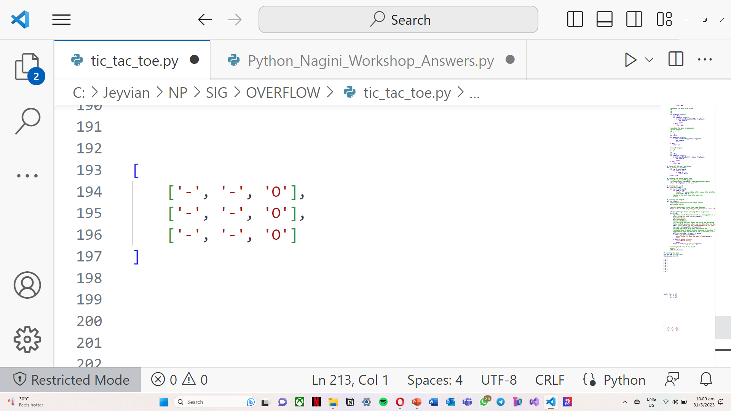
Win – Column
First Column:
nested_list[0][0]
nested_list[1][0]
nested_list[2][0]
Second Column:
nested_list[0][1]
nested_list[1][1]
nested_list[2][1]
Third Column:
nested_list[0][2]
nested_list[1][2]
nested_list[2][2]

Slide 45
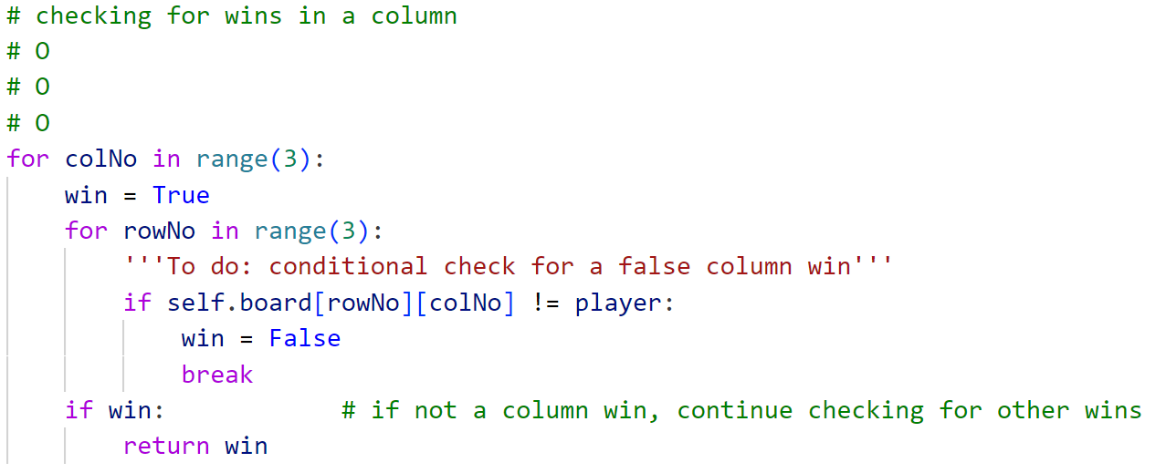
Win – Column
Notice that each row win have the same column number (second index)
Hence loop through each column first then the row to check for a column win

Slide 46
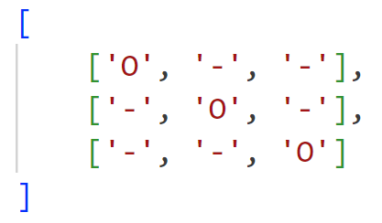
Win – Decreasing Diagonal
Wins:
nested_list[0][0]
nested_list[1][1]
nested_list[2][2]
Notice that both the row and column number are the same!

Slide 47
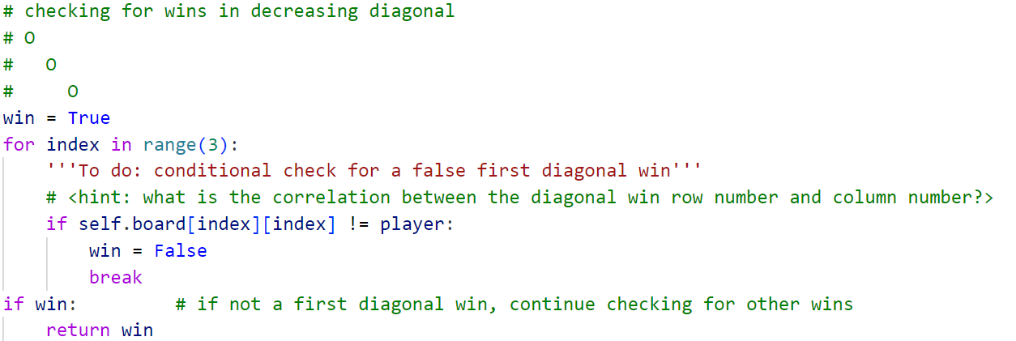
Win – Decreasing Diagonal
Row index is equals to the column index
Hence loop through a common index

Slide 48

Win – Increasing Diagonal
Wins:
nested_list[0][2]
nested_list[1][1]
nested_list[2][0]
Notice that rowNumber + columnNumber = 2

Slide 49
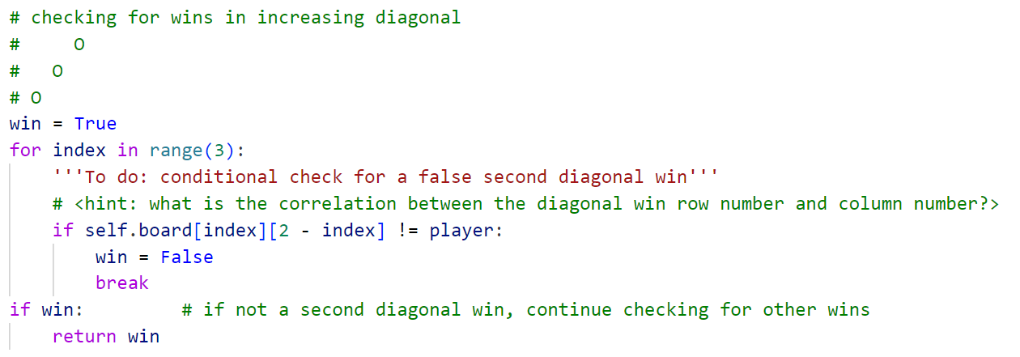
Win – Increasing Diagonal
Column Number = 2 – Row Number
Hence loop through a common index

Slide 50
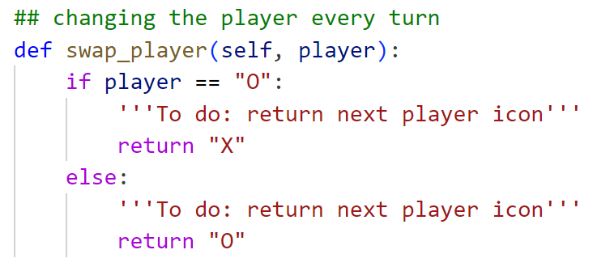
Swapping Players
Returning the next player’s turn given the current player

Slide 51
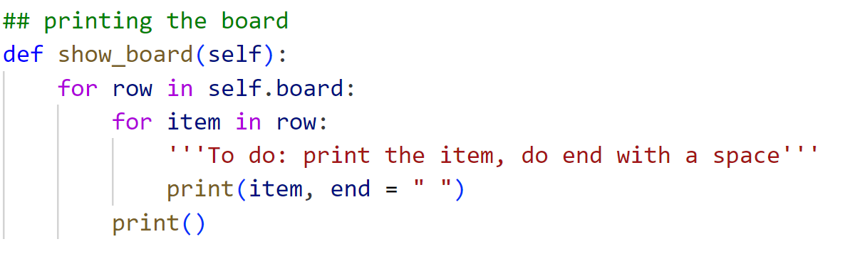
Printing the Board
Printing out the contents of the board by:
Looping through each row
Printing out the items
print() statement at the end goes to the next line for the next row

Slide 52
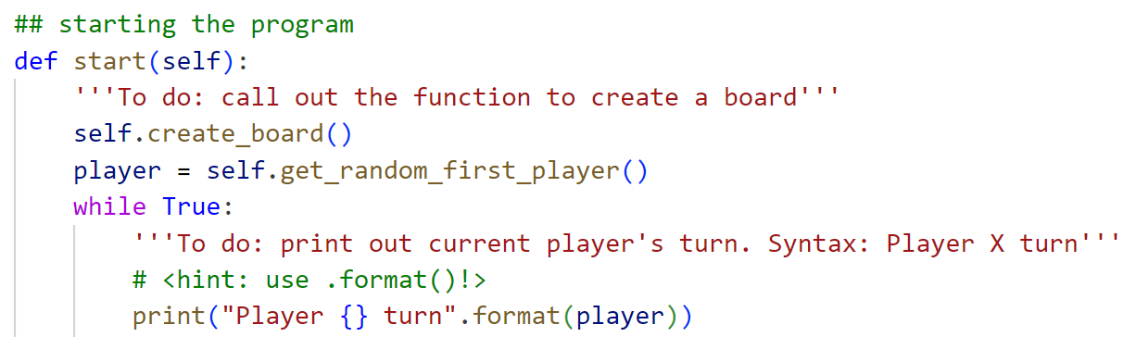
Starting the Program
Calling out the function to create the board: self.<method>()
String formatting using .format()

Slide 53
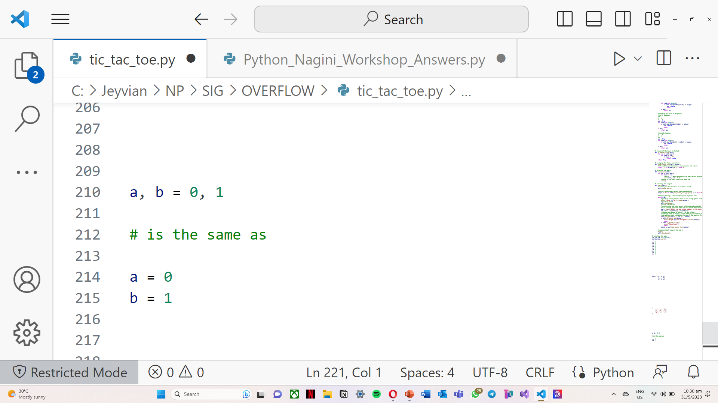
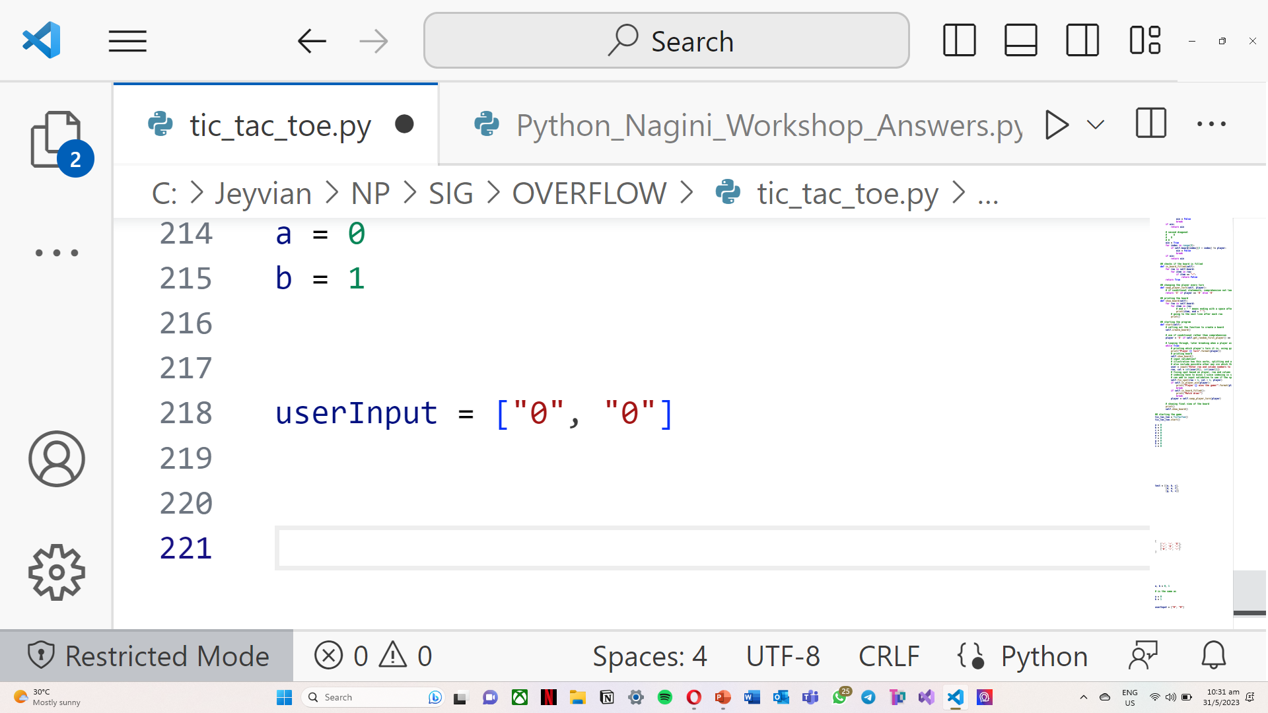
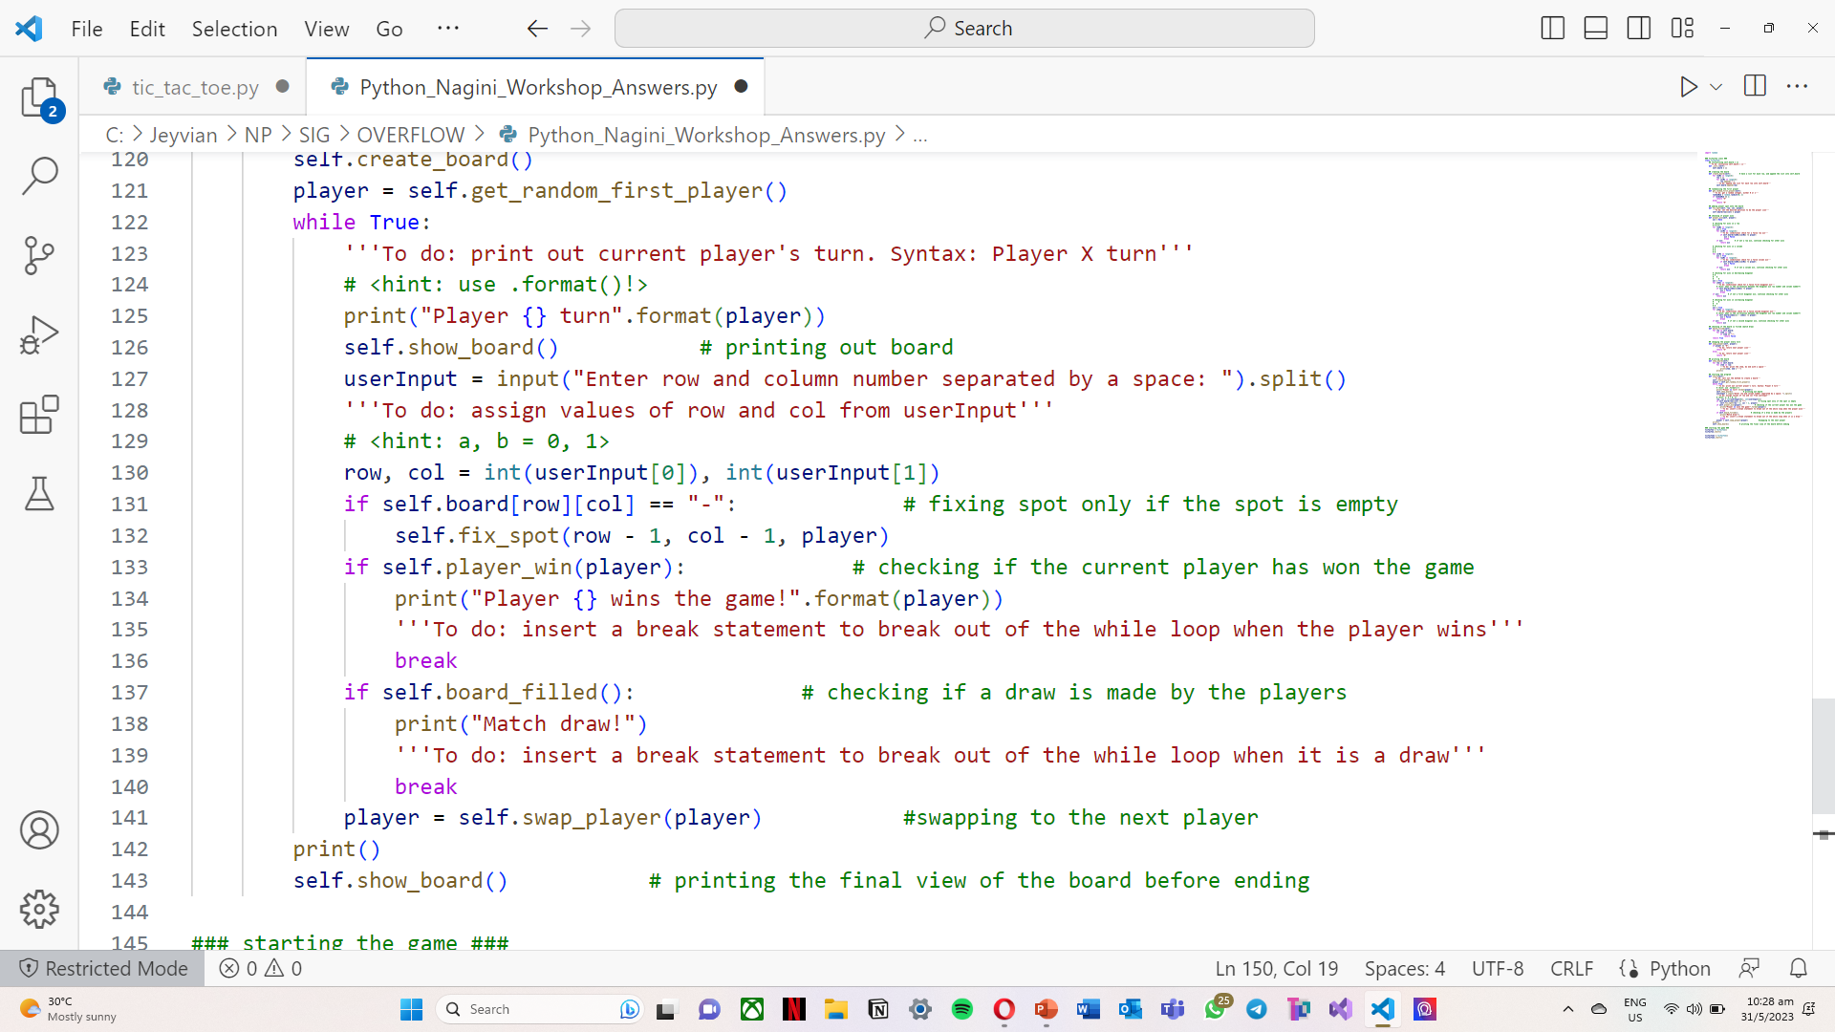
Starting the Program
You can assign values to multiple variables at the same time using a comma in between

Slide 54
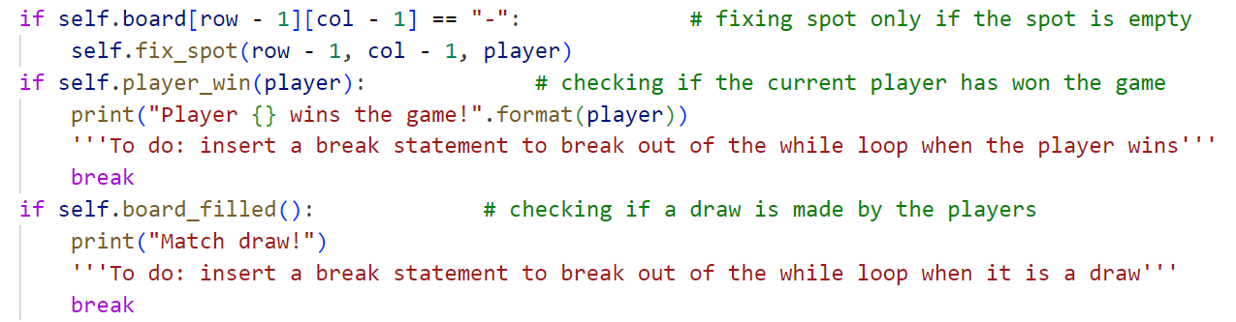
Starting the Program
Breaking out of the while loop when it is a draw → game ends

Slide 55
You have Completed the Program!
Run the program and play with your friends!
The index to use in the Tic Tac Toe are from 1 – 3, not index in Programming!

